Slide 1
Detroit River Case Study
A “3-dimensional Detroit River Flow model ” developed by Dr. S. Reistma (formerly of the University of Windsor);
Include the “near-bottom water velocity” to the habitat attribute variables in the environmental data matrix;
213 Detroit River sites (1991, 1999 and 2004);
Identical multivariate analysis procedure.

Slide 2
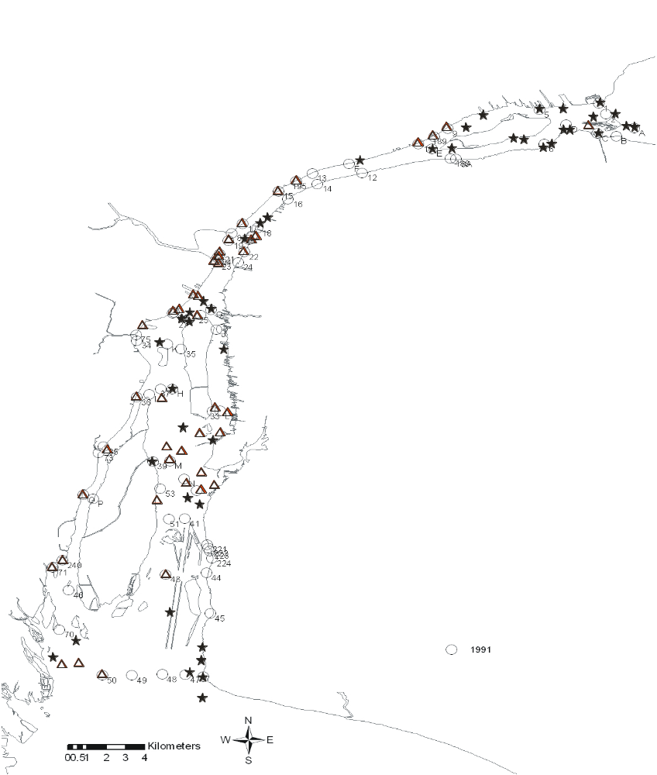
Distribution of Reference and Degraded sites in 1991, 1999 and 2004 Detroit River case study
Lake St. Clair
Rouge River
Ecorse River
Detroit River
Trenton Channel
N
Lake Erie

Slide 3
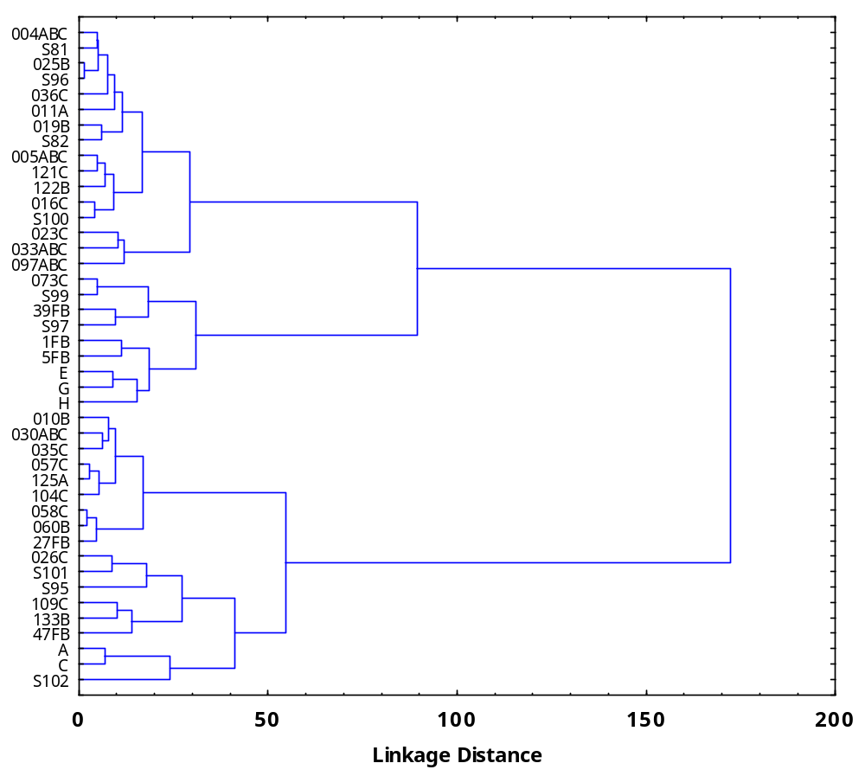
Cluster DR1
Cluster DR2
Cluster DR3
Dendrogram of Reference Detroit River sites (n = 43) grouped according to similar zoobenthic community composition

Slide 4
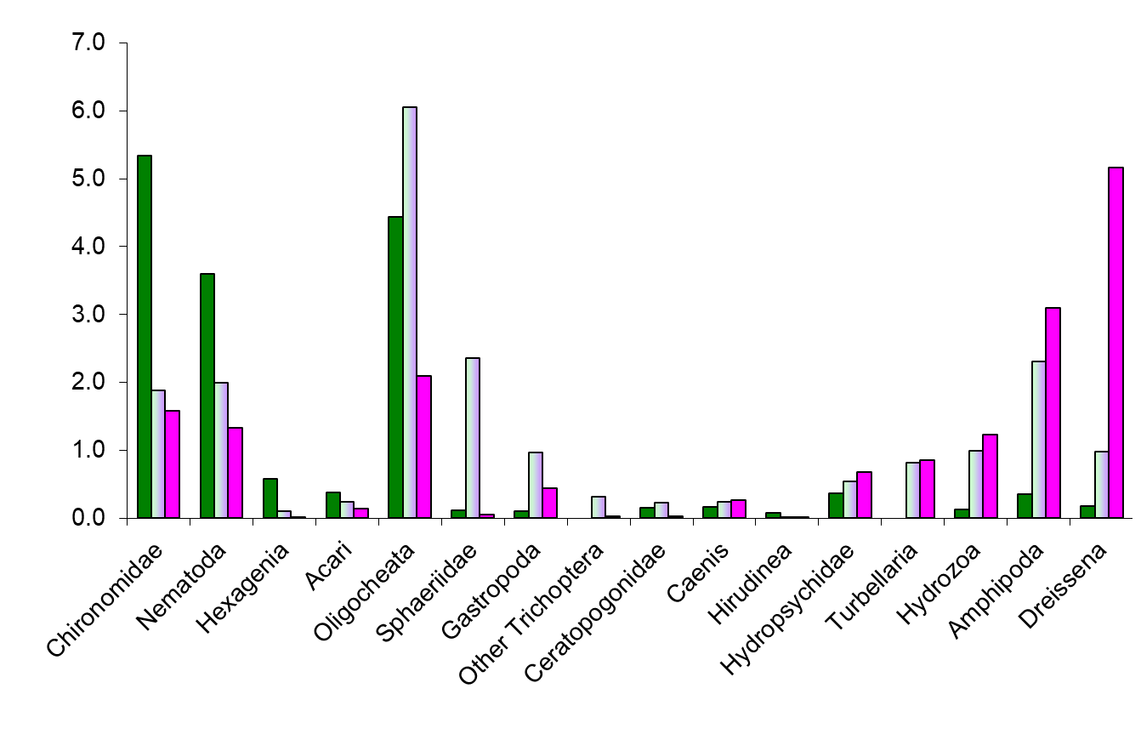
Mean value of taxa relative abundance for three clusters of zoobenthic communities found in the Reference sites of the Detroit River
Zoobenthic Relative Abundance (octave scale)
Cluster DR1: Depositional
Cluster DR2: Mixed
Cluster DR3: Erosional
Taxon

Slide 5
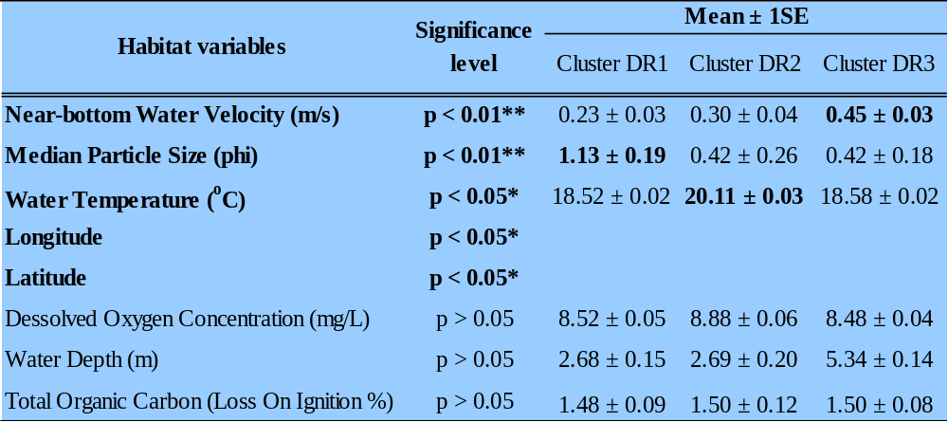
Habitat variables put into the DFA model describing discriminant functions and their mean (±1SE) in the 43 Detroit River Reference sites
Discriminant Function Analysis (DFA)

Slide 6
Classification of 213 Detroit River sites :
69 sites - habitat characteristic of cluster DR1 (depositional)
72 sites - habitat characteristic of cluster DR2 (Mixed)
72 sites - habitat characteristic of cluster DR3 (Erosional)

Slide 7
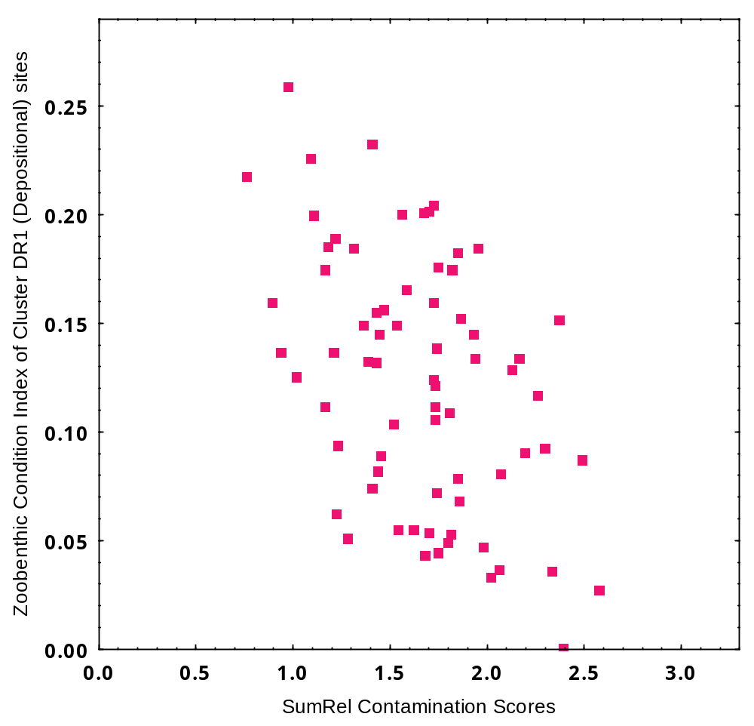
Cluster DR1 (n = 69 sites)
Reference
Nematoda
Degraded
Oligochaeta
Relationship between ZCI and SumRel for sites in cluster DR1

Slide 8
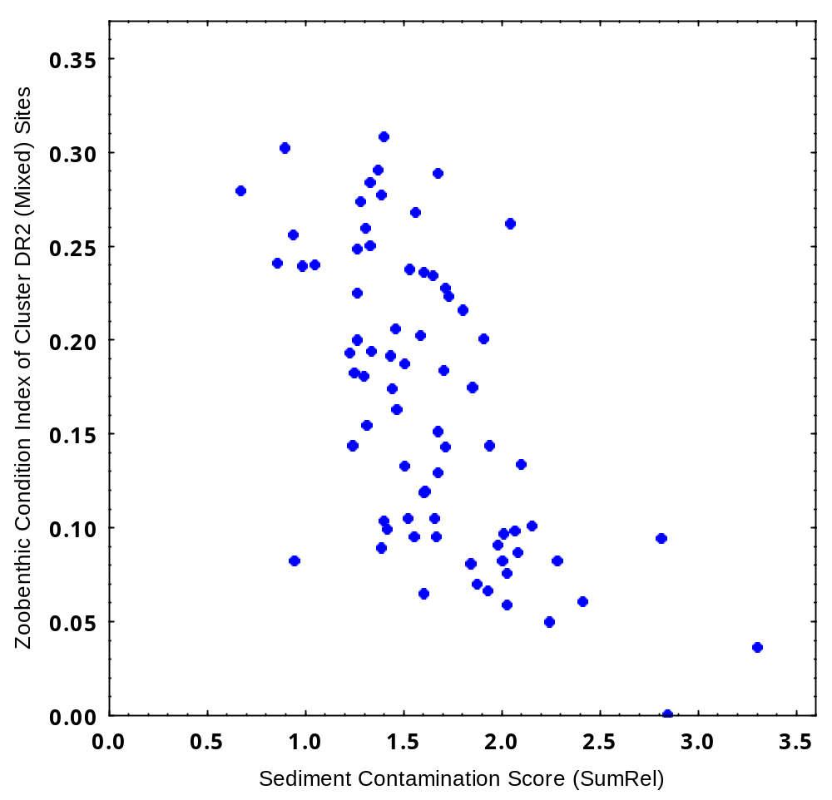
Cluster DR2 (n = 72 sites)
Reference
Chironomidae
Nematoda
Degraded
Oligochaeta
Gastropoda
Relationship between and SumRel for sites in cluster DR2

Slide 9
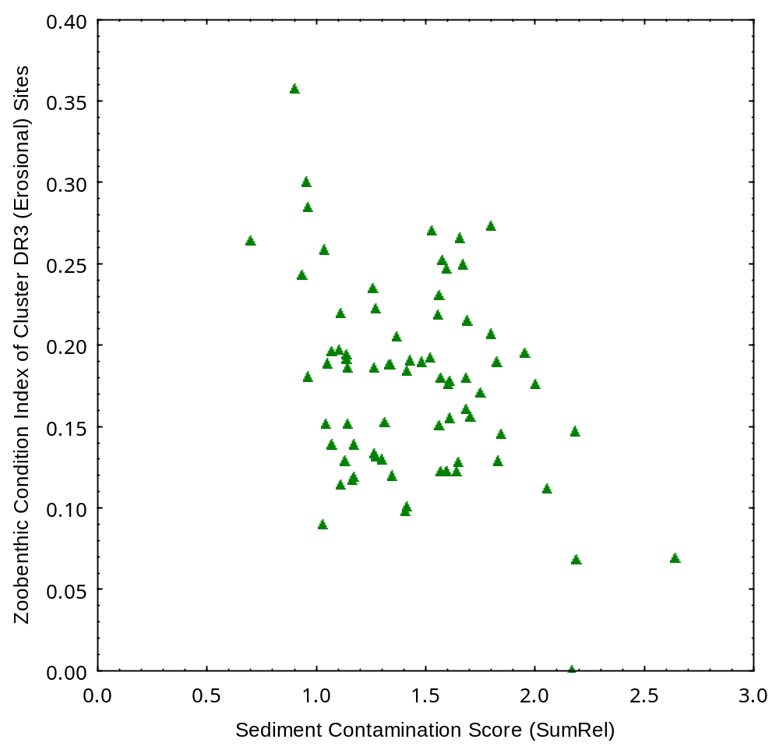
Cluster DR3 (n = 72 sites)
Reference
Dreissena
Degraded
Oligochaeta
Relationship between ZCI and SumRel for sites in cluster DR3

Slide 10
Forward stepwise multiple regression: ZCI equations to assess the environmental condition of a site under different habitat attributes
ZCI = 0.136 + 0.027*Chironomidae – 0.014*Oligochaeta
ZCI = 0.295 - 0.028*Oligochaeta + 0.039*Hydropsychidae + 0.034*Chironomidae + 0.031*Dreissena
ZCI = 0.136 + 0.027*Chironomidae – 0.014*Oligochaeta
ZCI = 0.295 - 0.028*Oligochaeta + 0.039*Hydropsychidae + 0.034*Chironomidae + 0.031*Dreissena
ZCI = 0.136 + 0.027*Chironomidae – 0.014*Oligochaeta
ZCI = 0.295 - 0.028*Oligochaeta + 0.039*Hydropsychidae + 0.034*Chironomidae + 0.031*Dreissena
ZCI (Depositional) = 0.161 + 0.020*Nematoda - 0.020*Oligochaeta
ZCI (Mixed) = 0.110 + 0.020*Chironomidae + 0.026*Nematoda - 0.008*Gastropoda - 0.004*Oligochaeta
ZCI (Erosional) = 0.141 + 0.018*Dreissena – 0.021*Oligochaeta

Slide 11
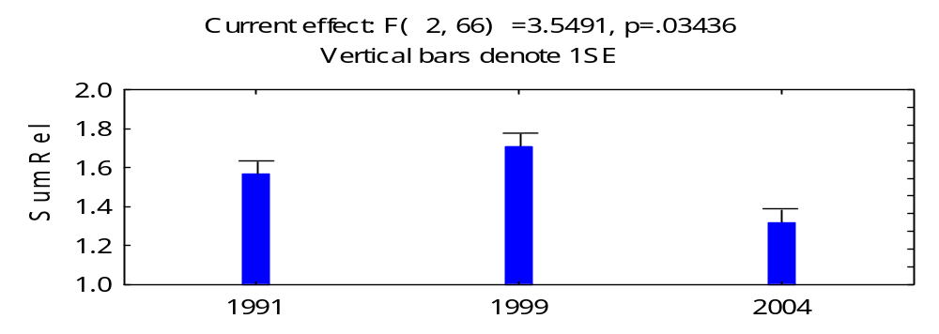
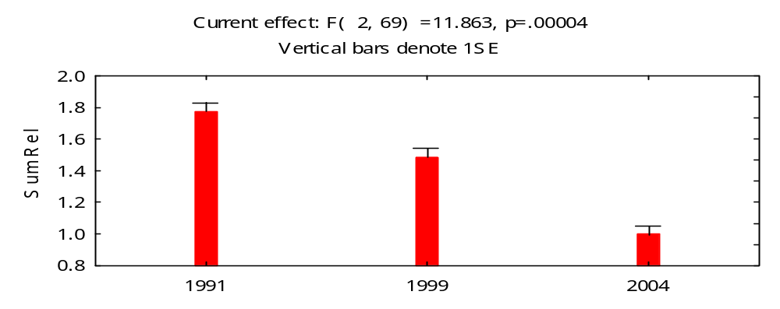
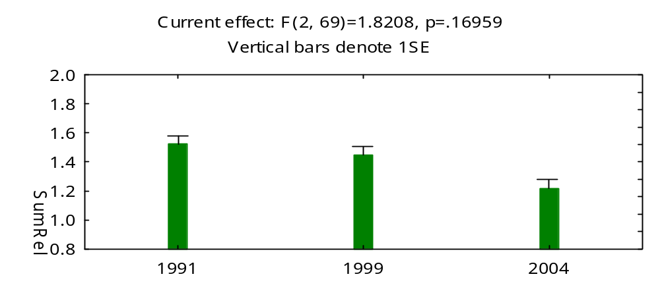
Mean SumRel Contamination Scores of 3 cluster sites among years 1991, 1999 and 2004 in Detroit River
a
a
Cluster DR1 (Depositional)
b
a
b
Cluster DR2 (Mixed)
c
Cluster DR3 (Erosional)
a
a
a

Slide 12
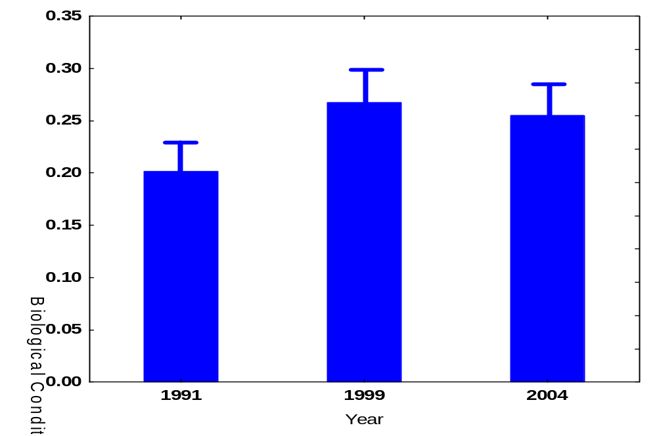
Comparison of mean ZCI scores among 3 years (1991, 1999 and 2004) at 8 corresponding sites in the Detroit River. Repeated measures ANOVA F[2,14] = 3.15, p = 0.074. Vertical bars denote 1SE
a
a
a

Slide 13
Study 1: Conclusions and Discussion (1)
When environment quality is uniformly good (equivalent to reference; SumRel contamination score <1.0, ZCI >0.10), the zoobenthic community is believed to be unique in areas with different benthic habitat characteristics:
    depositional group
    (mixed group)
    erosional group
Statistically significant negative relationships between biological condition and sediment contamination for all clusters were found. Sites with coarser substrates tend to have stronger correlations;
The RDC multivariate approach used in this study provides an objective way to assess aquatic environmental condition by using zoobenthic community composition as indicators;

Slide 14
Study 1: Conclusions and Discussion (2)
There is evidence that the overall sediment quality of the Detroit River between 1991 and 2004 has been improved;
No statistically significant difference in Zoobenthic Community condition (ZCI) was found between 1991 and 2004 (repeated measures ANOVA; n=8)

Slide 15
Study 2:
Use of Chironomidae (Diptera) mouthpart deformities to assess environmental degradation in the Lake Huron-Lake Erie Corridor

Slide 16
Chironomidae (Diptera) Mouthpart Deformities
Not all environmental changes can be detected at the community level.
Individual organisms may respond to stressors before the community, and are possibly more sensitive indicators of degradation (Warwick 1990a).
Chironomidae can metabolize & bioaccumulate organic chemicals bioaccumulate persistent compounds, and exhibit significantly elevated incidences of deformities (IJC 1987; Warwick 1988).

Slide 17
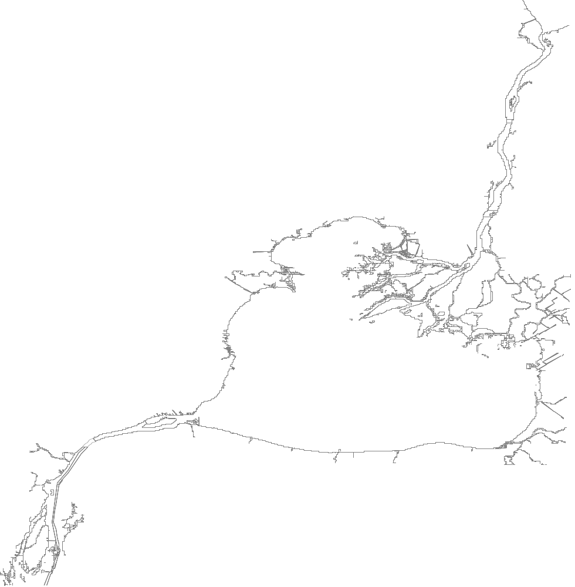

Sampling zones for Chironomid mouthpart deformity study, Lake Huron-Lake Erie Corridor, 2004/5
Lake Huron
Sarnia
St. Clair River
1ASR
2CSR
3ASR
St. Clair Delta
4CSR
MI
Anchor Bay
1LSC
Detroit
2LSC
Walpole Island
3LSC
1ADR
Lake St. Clair
4LSC
Detroit River
2CDR
Peche Island
Windsor
3ADR
ON
Turkey Island
N
4CDR
Trenton Channel

Slide 18
Results of Study 2
Distribution of chironomid genera:
  5,007 larvae ; 43 genera
Incidence of mentum deformities:
  3,117 individuals in 6 genera examined
    Chironomus
    Dicrotendipes
    Phaenopsectra/Tribelos
    Polypedilum
    Procladius
    Tanytarsus
Significant spatial and taxonomic variation
(G-statistic Goodness of Fit test; p<0.05).

Slide 19
Jan Ciborowski:
Why not use grey vs. red lettering to denote areas with elevated incidences of deformities (red) from those with background levels (grey)?
Lake Huron
Spatial variation: Zones had elevated incidence of mentum/ligula deformities (% ± SE)
Sarnia
St. Clair River
1ASR
2CSR
Chironomus
(16.00 ± 7.33%, n=25)
Dicrotendipes
(8.89 ±4.24%, n=45)
3ASR
St. Clair Delta
4CSR
MI
Anchor Bay
1LSC
Detroit
2LSC
Walpole Island
Chironomus (25.00 ± 21.65%, n=4)
Procladius (25.00 ±15.31%, n=8)
3LSC
Chironomus
(12.24 ± 3.31%, n=98)
1ADR
Lake St. Clair
4LSC
Detroit River
2CDR
Peche Island
Windsor
3ADR
ON
Turkey Island
N
4CDR
Trenton Channel

Slide 20
Taxonomic variation: Incidence of mentum / ligula deformity (% ± 1SE) of six genera collected from the corridor, 2004/5
Genus | Deformed Mentum (% ± 1SE) | Sample size (n) | Baseline Level (%)
Chironomus | 5.43 ± 1.15 | 387 | 2.65
Dicrotendipes | 2.64 ± 0.67 | 569 | 2.30
Phaenopsectra /Tribelos | 1.90 ± 0.77 | 316 | 2.90
Polypedilum | 2.08 ± 0.39 | 1395 | 4.31
Procladius | 2.16 ± 1.23 | 139 | 2.73
Tanytarsus | 0.32 ± 0.32 | 311 | 1.98

Slide 21
Study 2: Conclusions and Discussion
Three zones had elevated incidence of mentum/ligula deformities;
Only Chironomus exhibited elevated incidence of deformities;
The most heavily polluted zones (e.g., downstream Detroit R.) had few organisms other than oligochaetes; no statistical trends were evident.

Slide 22
General discussion and conclusion
The combination of using community and individual indicators to assess habitat quality is more powerful than use of individual bioindicators;
The results from my two studies provided complementary information and together gave an overall assessment of the corridor biological condition:
“Best available biological conditions”: “Reference” sites (study 1) without elevated incidence of Chironomidae mouthpart deformities (study 2);
“Less suitable biological conditions”: “Non-degraded” sites (study 1) with elevated incidence of chironomidae mouthpart deformities (study 2);
“Degraded biological conditions”: “Degraded” sites (Study 1) with elevated incidence of Chironomidae mouthpart deformities (Study 2);
“Severely degraded biological conditions”: “Degraded” sites (Study 1) without incidence of Chironomidae mouthpart deformities (Study 2);

Slide 23

Study 1 &2: Assessment of overall benthic habitat condition of the Lake Huron-Lake Erie Corridor
St. Clair River
St. Clair Delta
Walpole Island
Lake St. Clair
Detroit River

Slide 24
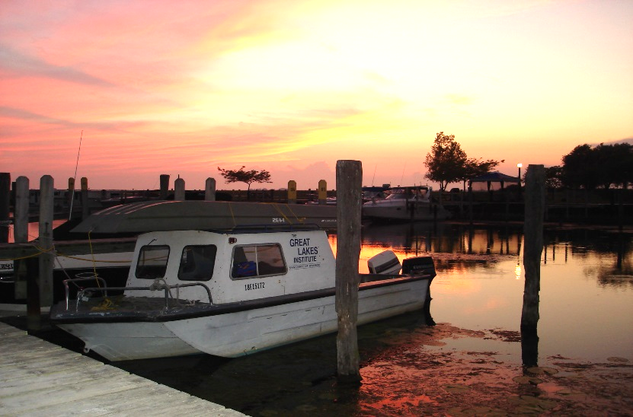
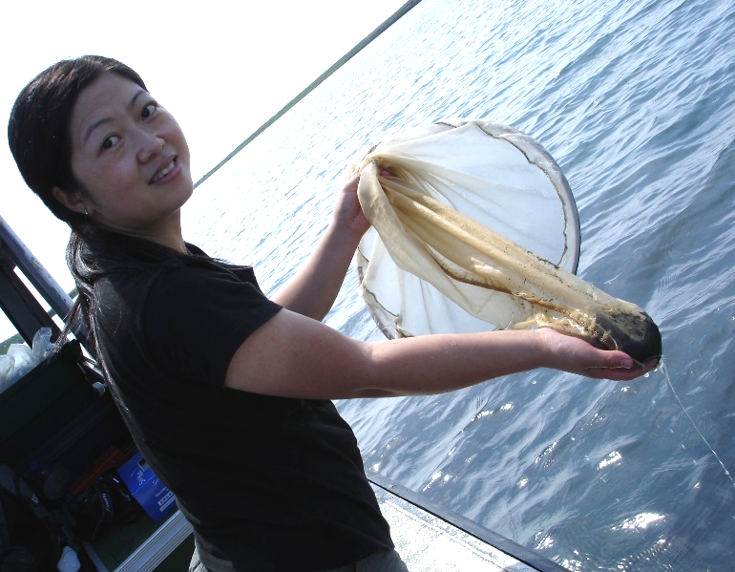
Acknowledgements
Dr. Jan Ciborowski
Dr. Ken Drouillard
Dr. Ihsan Al-Aasm
Dr. Doug Haffner
Dr. Eva Szalinska
Mrs. Li Wang
Mr. David Qiu
Fellow Graduate students
Friends in Ciborowski lab
Great Lakes Sustainability Fund
  Environment Canada
  Ontario Ministry
  of the Environment
  NSERC

